Slide 1


Welcome you all
Application Layer
D.Sakthivel
Assistant Professor & Trainer,
KG Micro College
KGiSL Campus, Coimbatore – 641 035.

Slide 2
Application Layer

Slide 3
APPLICATION LAYER - Protocols
Web Apps: HTTP, HTTPS
Mails: POP, SMTP, IMAP
DNS, FTP, SSH, etc.
IP Address
It is very difficult to memorize the IP address.
Things get more complicated when, as users, we access various websites and services.
It becomes quite a challenge when the addresses of those services are dynamic.

Slide 4
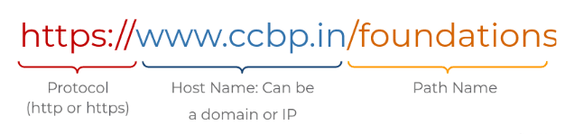
UNIFORM RESOURCE LOCATOR (URL)

Slide 5
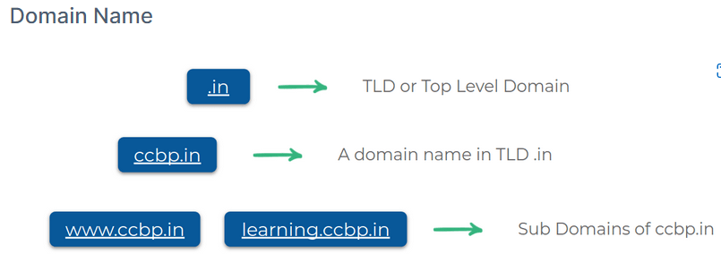
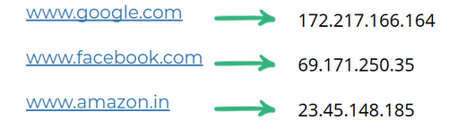

Slide 6
Domain Name Servers
Root Name Servers redirect to appropriate TLD Name Server.
TLD Name Server redirect to appropriate Authoritative Name Server for the domain.
Authoritative Name Server gives the appropriate IP for the domain.
Caching and Recursive Name Servers are provided by ISP. These reduce the load on the root, tld, authoritative name servers.

Slide 7
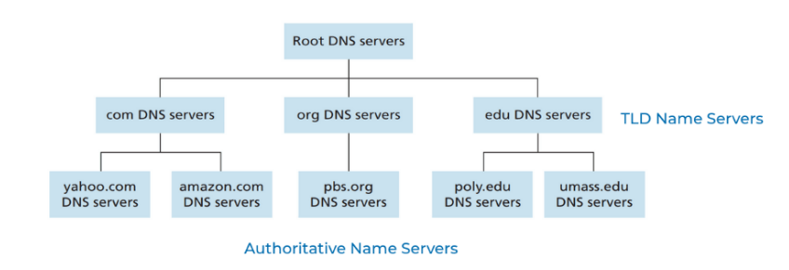
Root Server

Slide 8
DNS Resolution
The first step is always to contact a root named server.
The root servers will respond to a local DNS server with the TLD name server that should be queried like (.in). For each TLD in existence, there is a TLD name server.
The TLD name servers will respond again to the Local DNS server with what authoritative DNS server(.ccbp.in) to contact.
The Local DNS server could be redirected at the authoritative server for ccbp.in which would finally provide the actual IP of the server in question.

Slide 9
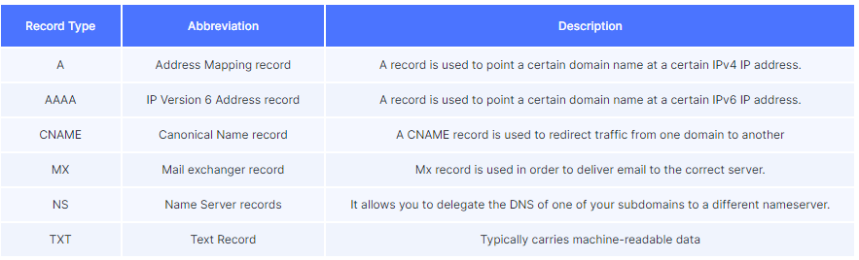
DNS Record Type

Slide 10
WEB – CLIENt SERVER APPLICATION
A standard for document formats (HTML).
Web Browsers.
Web Servers.
Relies on HTTP, HTTPS application-layer protocols which rely on TCP.

Slide 11
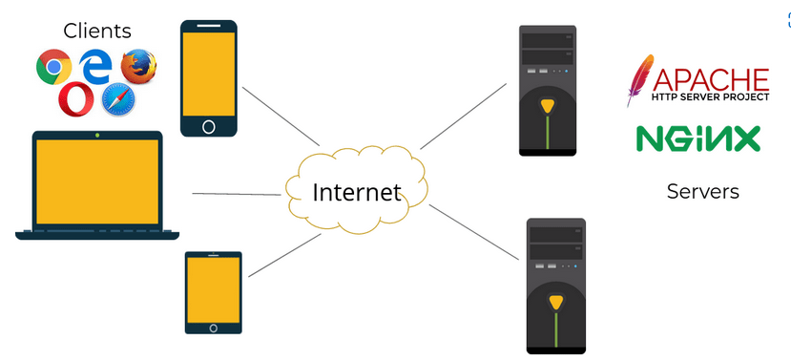
Client Server Architecture

Slide 12
Web Servers
They host Web objects, each addressable by a URL.
A Web server is always ON, with a fixed IP address.
80 is default port used by a HTTP web server.

Slide 13
HTTP
Request & Response
The messages sent by the client usually a Web browser, are called requests.
The messages sent by the server as an answer are called responses.

Slide 14
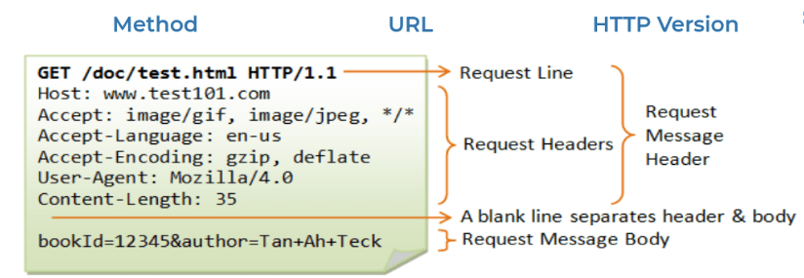
Request
A HTTP request consists of a Request Header and a Request Body.
A Request Header contains various info like:
Host :
(Example: developer.mozilla.org)
Method : (Example: GET).
Path : (Example: /).
HTTP version :
(Example: HTTP/1.1).

Slide 15
HTTP Method
GET : retrieves data, like a blog article.
POST : creates data, like a new blog article.
PUT : replaces data, like an existing blog article.
DELETE : deletes data, like an existing blog article.

Slide 16
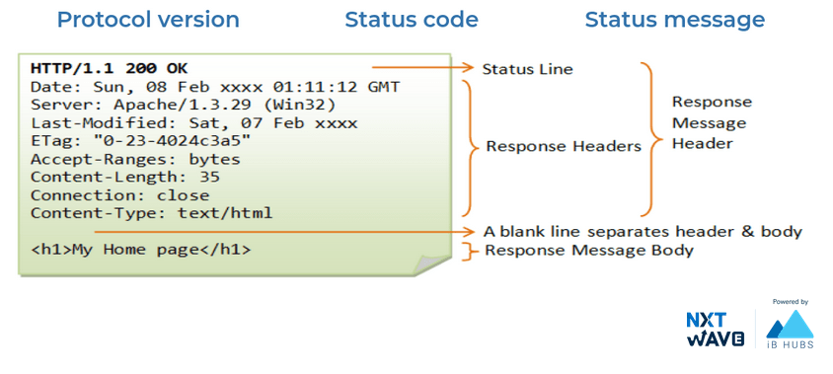
RESPONSE

Slide 17
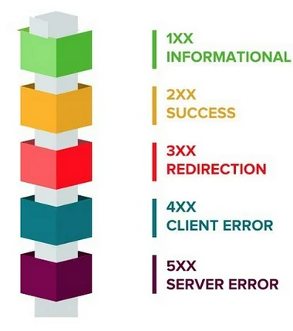
HTTP Response Codes
A HTTP response of a Response Header and a Response Body.
A Response Header contains various info like:
Response Code : (1XX, 2XX, 3XX, 4XX, 5XX).
Content Type : (e.g.: text/html, image/png).
Content Length.

Slide 18
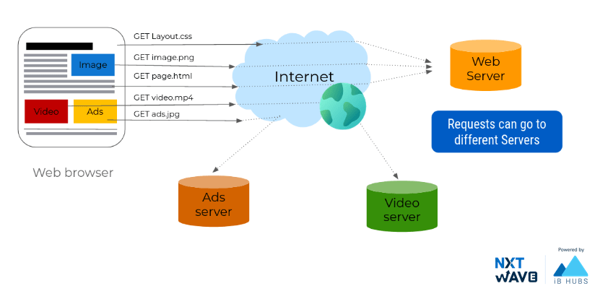
Hypertext Transfer Protocol

Slide 19
Computer Networks
Transferring Data Over Network
The header (and footer) and the data together form the Protocol Data Unit (PDU) for the next layer.
The process continues until reaching the lowest-level layer (physical layer or network access layer), from which the data is transmitted to the receiving device.
The receiving device reverses the process, de-encapsulating the data at each layer with the header and footer information directing the operations.
Then the application finally uses the data.
The process is continued until all data is transmitted and received.

Slide 20
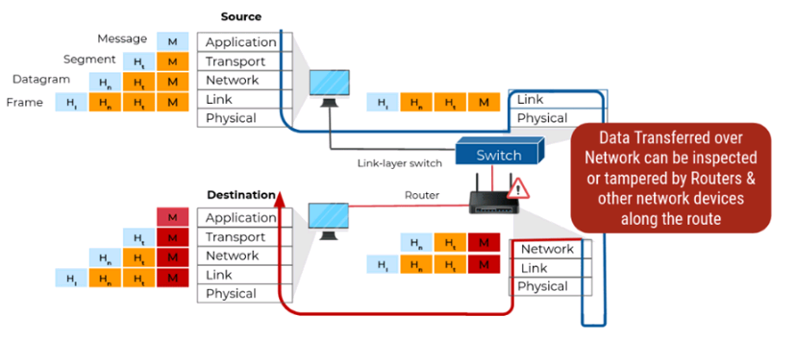
Computer Networks

Slide 21
HTTPS Protocol
HTTP Secure Protocol encrypts the data between the Browser and Server.
Protects the privacy and security of the users.
Protects the integrity of the website.
Uses 443 port by default.

Slide 22



Thank You

